Slide 1
SLYYDE:
Andrew Dodel, Andrew Jia, Brendan Campbell, Sundar Sampath, Yuxin Zhang

Slide 2
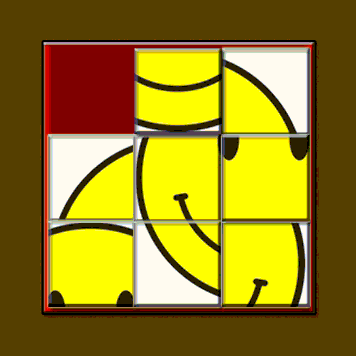
Problem Statement
Our aim is to create a web application, Slyyde, that allows users to play slide puzzle games.

Slide 3
Why is it important?
Slide puzzles serve as fun distractions, that provide some degree of mental challenge.
Simple, concrete, feasible project that allows for our team to focus on the core principles of the software development process.

Slide 4
Functional Requirements
3.2.4 Game Board The game board shall consist of tiles, the number of which comes from the game difficulty. Tile placement shall always start randomized. 3.2.5 Game Moves One tile will be blank, and this is the tile that can be moved around and swap places with adjacent tiles . The player shall be able to move this tile by clicking adjacent tiles or using the “wsad” or arrow keys. 3.2.9 Game Completion Upon successful completion of a game, the application shall display a congratulatory message to the user, displaying the score for that game.

Slide 5
Non-functional requirements
3.5.1 Performance Game moves should have a sub 1 second response time. Puzzles should be created within 5 seconds.
3.5.2 Reliability The game shall be reliable, having less than 1 crash per 100 games.
3.5.3 Usability 90% of users should be able to complete an easy difficulty puzzle. Users should misclick less than 10% of the time when using a mouse.

Slide 6
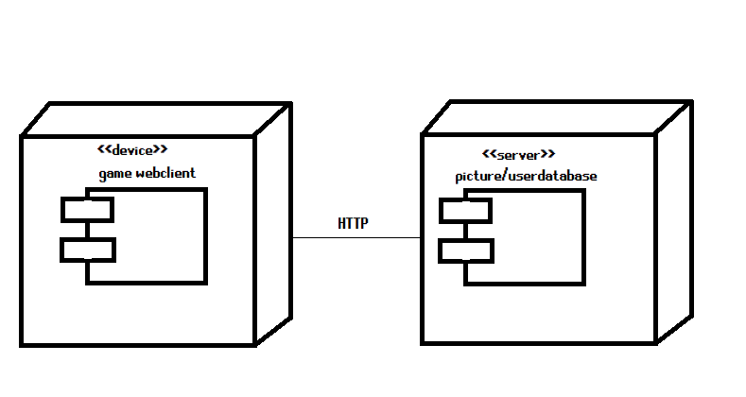
Deployment Diagram

Slide 7
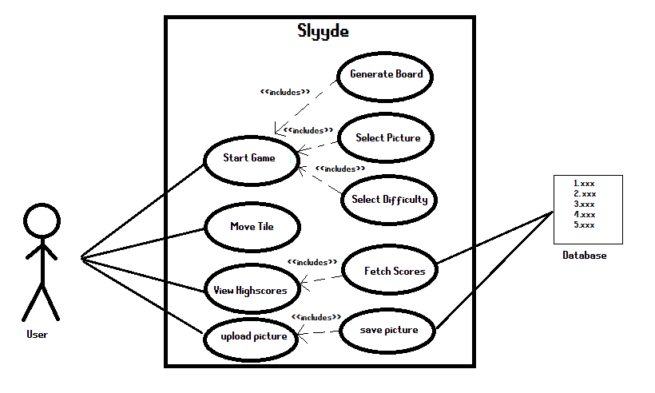
Use Case Diagram

Slide 8
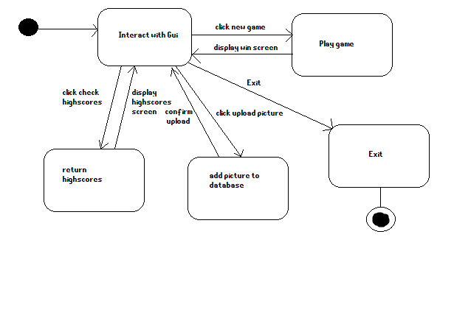
State Transition Diagram

Slide 9
Selected Tech stack including Database
HTML, CSS, Javascript - Frontend
Python based framework Flask - Backend
SQL Database

